Slide 1
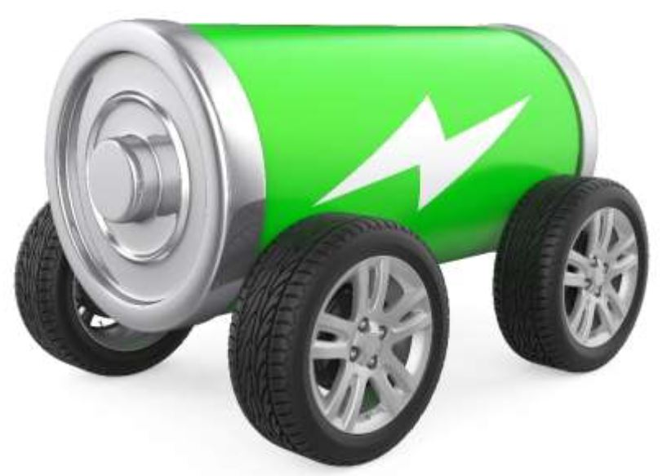
Battery Power!

Slide 2
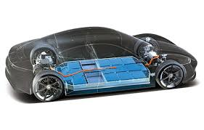
How do batteries power a car?
Batteries use a chemical reaction to create electricity
Electricity powers an electric motor
Motors exert force that turn the wheels of the car

Slide 3
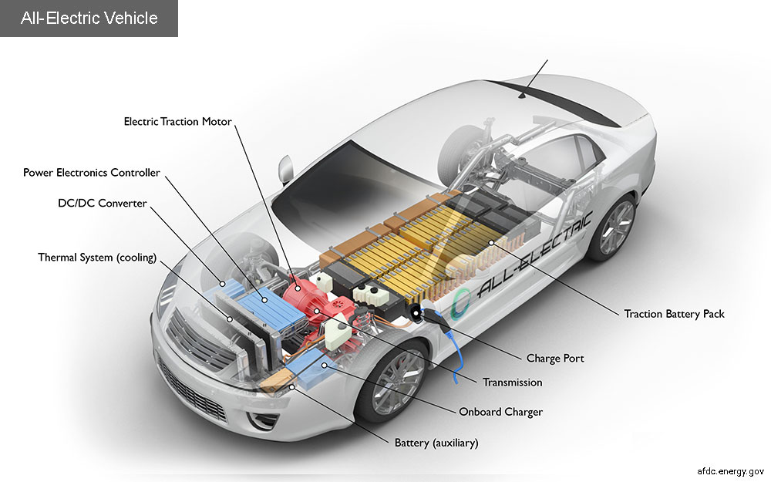
Energy 101: Electric Vehicles
https://www.nationalgeographic.org/video/edu-electric-vehicles/

Slide 4
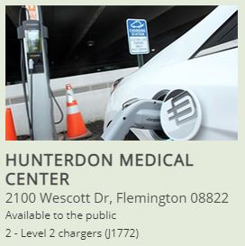
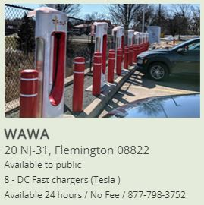
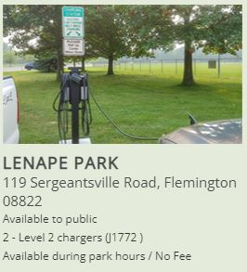
Where is the closest charging station?

Slide 5
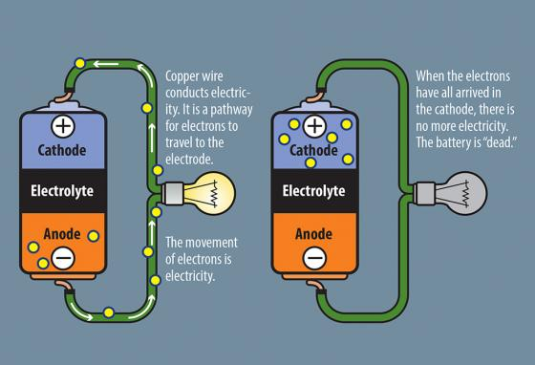
How batteries work

Slide 6
Electricity 101
Electricity is created by a flow of electrons
Volts are a measure of voltage
Amps are a measure of current
Watts are a measure of power
Ohm’s law helps us understand electricity
V = I * R
Where V is voltage (volts), I is current (amps), and R is resistance (ohms)

Slide 7
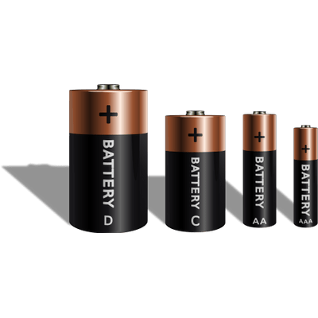
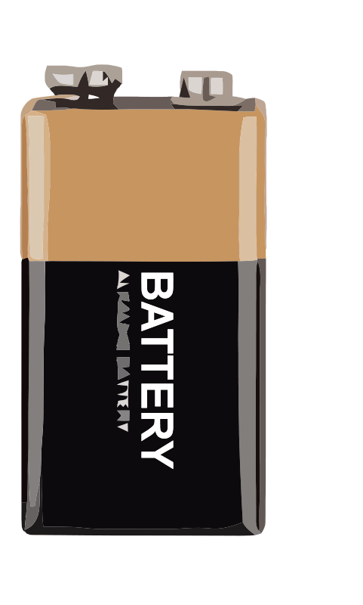
Batteries we will be studying
D battery
C battery
9-volt battery
AAA battery
AA battery

Slide 8
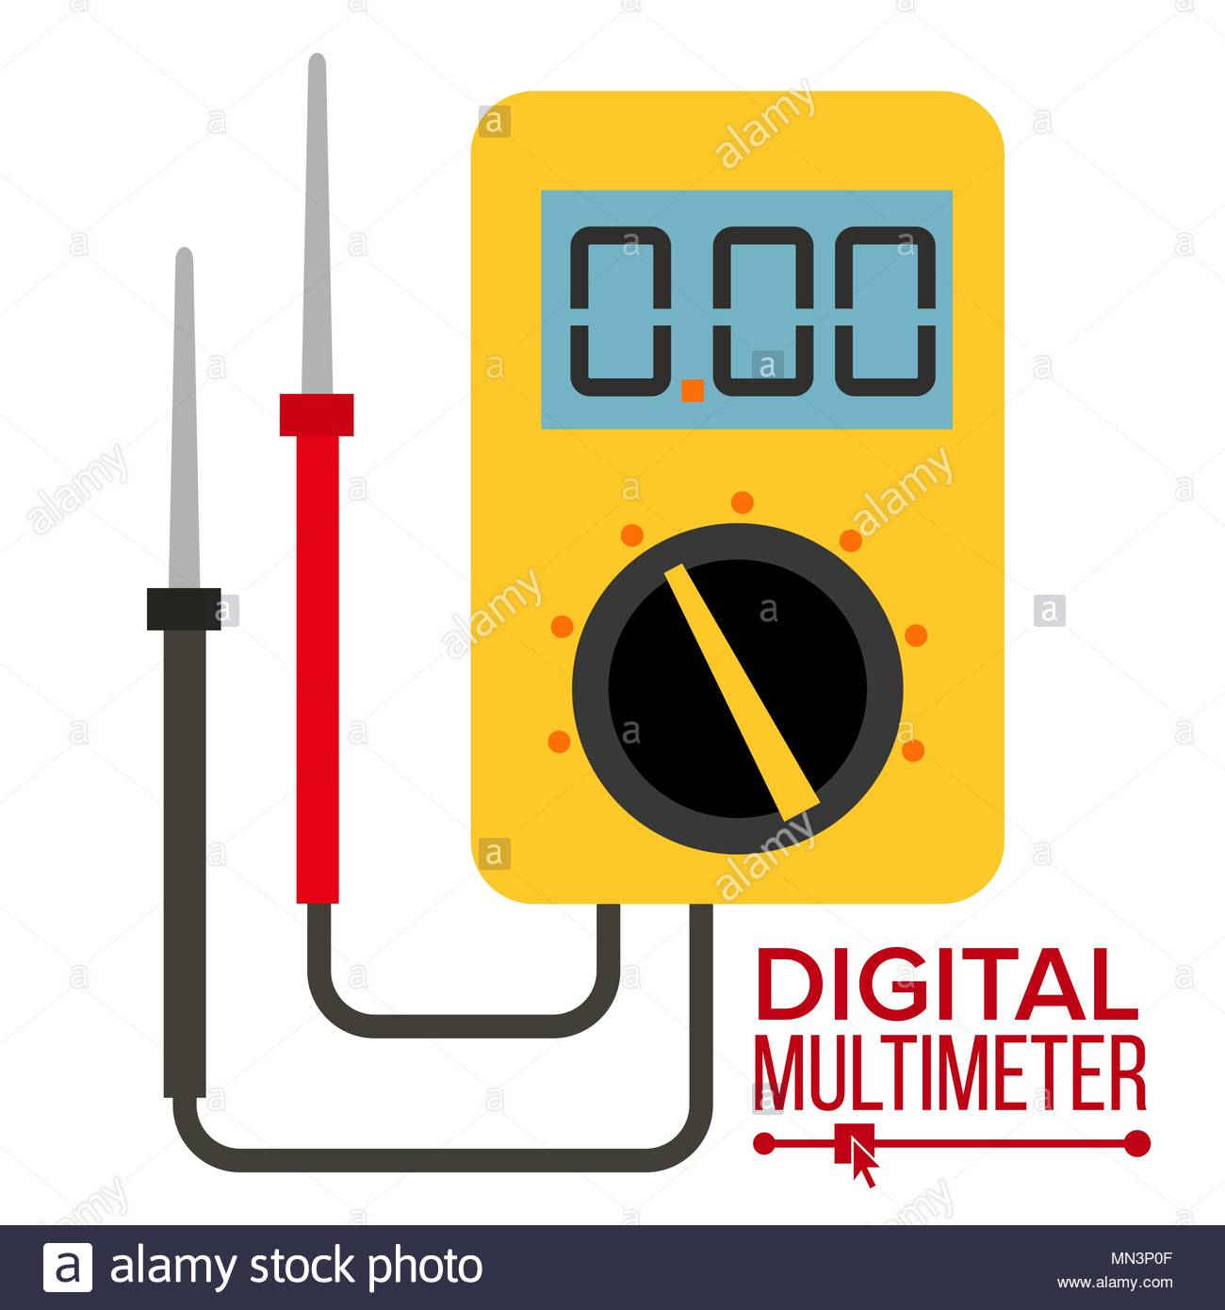
What is a multimeter?
A multimeter measures electric current or voltage.
Red probe for positive pole
Black probe for negative pole

Slide 9
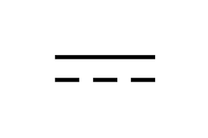
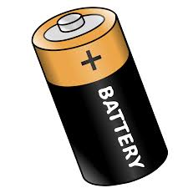
Check out some batteries
Turn knob on multi-meter to 20 in the direct current area
Explore each battery and record your findings in the worksheet
Write down any questions you have for discussion
V

